Slide 1



Prediction of poisonous mushroom
Qiye Chen
（main）
Tianxia Gao
（article）
24127311
23125241

Slide 2




Contents
01
Achievement Exhibition
02
Metrics & Result
03
Conclusion

Slide 3

01
Achivement Exhibition

Slide 4
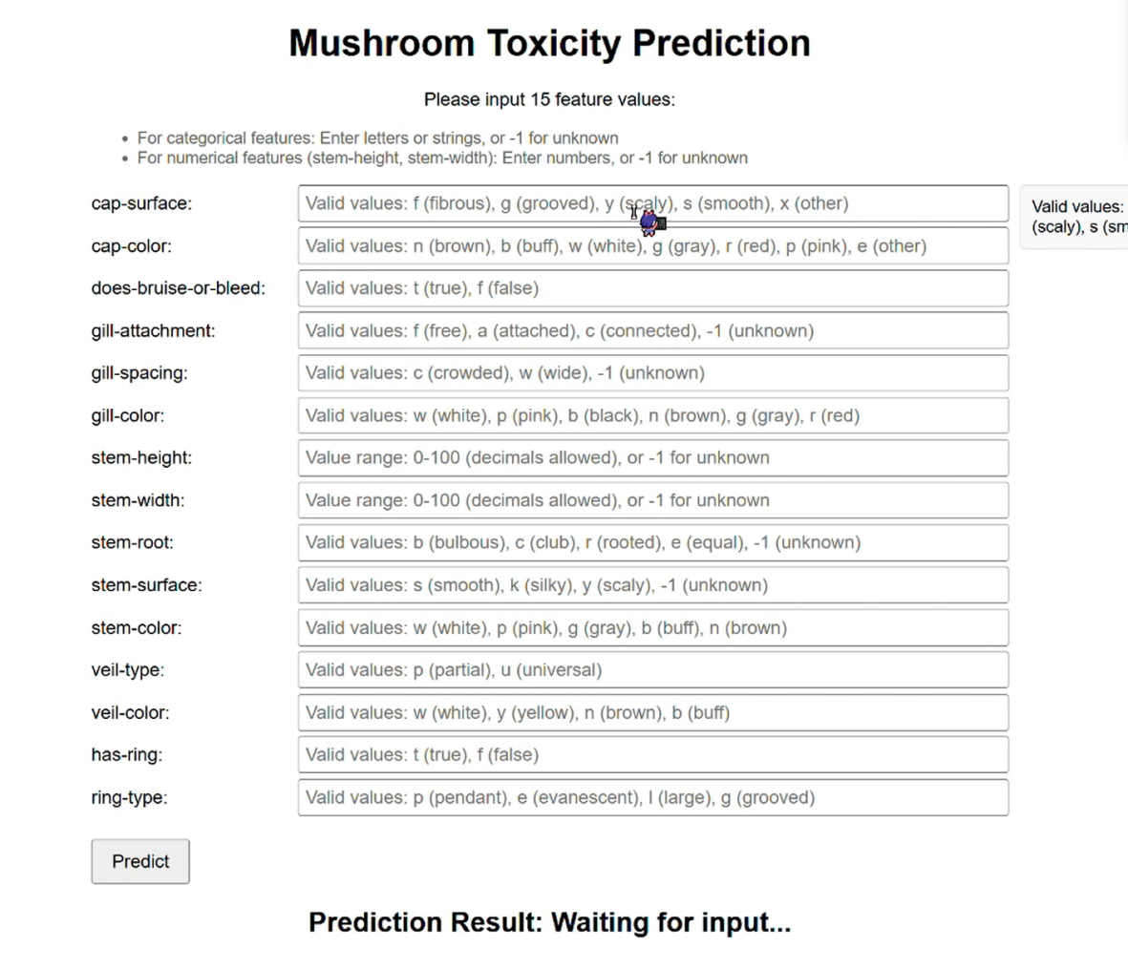

Achievement
Achieved over 98% accuracy:
Through the methods to be introduced later, our model has achieved extremely high accuracy
Frontend interface(p1):
Develop a frontend interface to test and demonstrate the prediction functionality through the API
p1:the frontend interface

Slide 5
02
Metrics & Result

Slide 6
Metrics
Accuracy: The proportion of correctly classified instances.
Decision Tree: Initial attempts with Decision Tree faced overfitting, as a single tree’s splitting logic struggled to generalize across diverse mushroom feature patterns.
Random Forest: To improve robustness, we switched to Random Forest using 2000 trees. The large ensemble, via bootstrapping and feature randomness, reduced overfitting and stabilized toxicity predictions.
Precision: The proportion of true positives among all positive predictions.
Recall: The proportion of true positives among all actual positives.
F1-score: The harmonic mean of precision and recall.
ROC curve: A graphical representation method used to evaluate the performance of classification models.
Confusion Matrix: A tabular tool used to evaluate the performance of classification model.

Slide 7
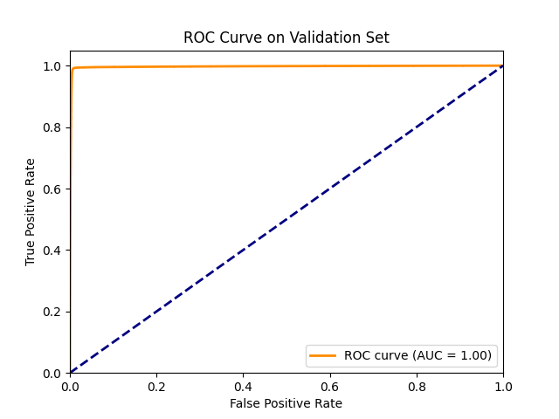
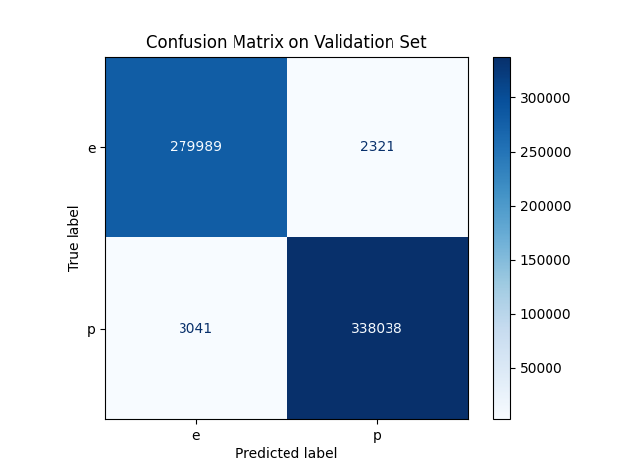
Result
Metrics | Result
Accuracy | over 98%
Best Max depth (Decision Tree) | depth 15
Best Max depth (Random Forest) | best max depth 22
Precision | 99%
F1-score | 99.1%
ROC curve | at the p2
Recall | 99.1%
Confusion Matrix | at the p3
p2
p3

Slide 8
03
Conclusion

Slide 9
Conclusion
Our project successfully developed a reliable prediction model for identifying poisonous mushrooms.By leveraging advanced data analysis methods and carefully selecting and tuning machine learning models, we were achieved a high level of accuracy in our predictions.

